Slide 1

Insights From Idealized MHD Simulations of Flux Emergence in the Solar Atmosphere
James Leake
Naval Research Laboratory (NRL)
james.leake@nrl.navy.mil
http://jleake1981.github.io/
Mark Linton, NRL
Ignaccio Ugarte-Urra, George Mason University
Tibor Török, Predictive Science Inc
Spiro Antiochos, NASA Goddard
Etienne Pariat, Paris Observatory
Aimee Norton, Stanford University
Leake at al., GMU Seminar, December, 2015

Slide 2
Contents
Background
MHD Simulations of Flux Rope Formation and Eruption
Helicity Injection in the Solar Atmosphere
Electrical Current Balance in the Corona
What’s next?
Leake at al., GMU Seminar, December, 2015

Slide 3
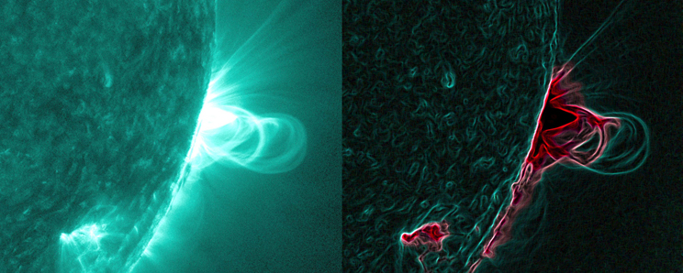
Solar Activity and Magnetism
Energy required for CMEs/eruptions/flares stored in the electric currents of coronal magnetic field
Most likely stored in twisted/sheared magnetic fields and flux ropes
How are flux ropes formed/erupted in the corona?
Courtesy: NASA Goddard, Angelos Vourlidas
Leake at al., GMU Seminar, December, 2015

Slide 4
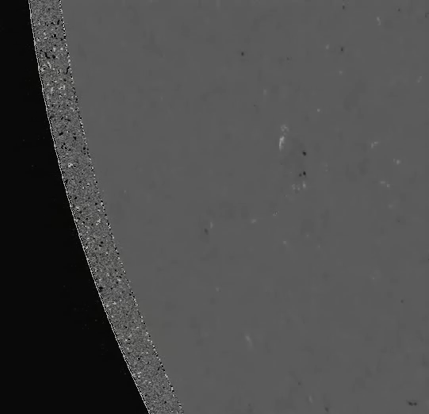
Solar Activity and Magnetic Flux Emergence
Active regions are regions of strong magnetic field where the magnetic flux increases over hours-days
Quiet AR typically a bipolar region with mainly potential (J=0) field
Observed motions, such as shearing and sunspot rotation, build up gradients in magnetic field (current)
Important quantity is the magnetic free energy
What is the cause of these energization motions (emergence, shearing, rotation)
Related to twisted flux tube emergence
Leake at al., GMU Seminar, December, 2015

Slide 5
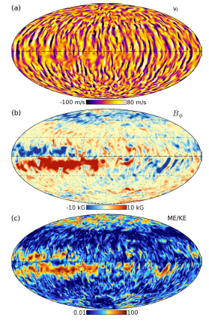
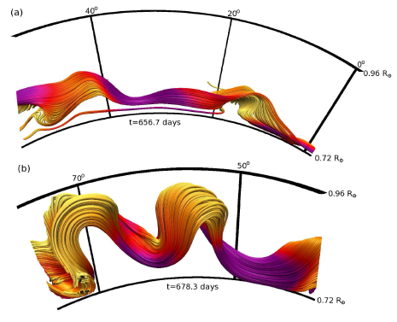
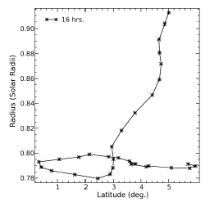
Buoyant Flux Tubes in Solar Dynamo Simulations
3D turbulent convective dynamo models
(Nelson et al. 2014)
Courtesy: N. Nelson
Dynamo Models able to produce buoyant flux tubes that rise towards the surface - How do they emerge?
Leake at al., GMU Seminar, December, 2015

Slide 6
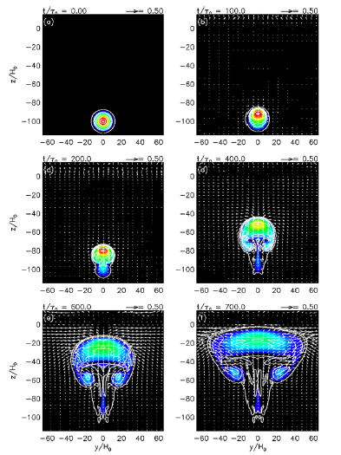
Brief History of Flux Emergence Studies
See Solar Physics Living Review by Cheung
Moreno-Insertis, Emonet (1998,1999)
Flux tubes need sufficient twist to survive shredding by vortical motions in the CZ
Archontis (2004), Murray et al. (2006, 2008), Toriumi et al. (2011)
Two-step emergence
Coherent rise halts at top of convection zone
Further emergence is via the Magnetic Buoyancy Instability (MBI), or undular Parker mode (does this determine observed emergence rate?)
Manchester (2004), Fan(2009), Mactaggart et al. (2009)
Very rare that CZ flux tube emerges bodily into corona
Partial emergence of twisted flux tube shows shearing and rotational motions
Leake at al., GMU Seminar, December, 2015

Slide 7
Open Questions Regarding Flux Emergence?
Can the emergence of CZ flux tubes explain observed AR feature/motions?
Sunspot Rotation/Shearing Motions/Flux Cancellation - that lead to energization of the corona
How do buoyant flux tubes emerge through the chromosphere and further into the corona? How do they interact with overlying field?
How does flux emergence drive eruptions in ARs?
How are coronal flux ropes formed if the CZ tubes do not bodily emerge?
How are electric currents distributed in the corona?
How is magnetic complexity (Helicity) injected into the corona?
We can use idealized simulations to help answer these questions
Leake at al., GMU Seminar, December, 2015

Slide 8
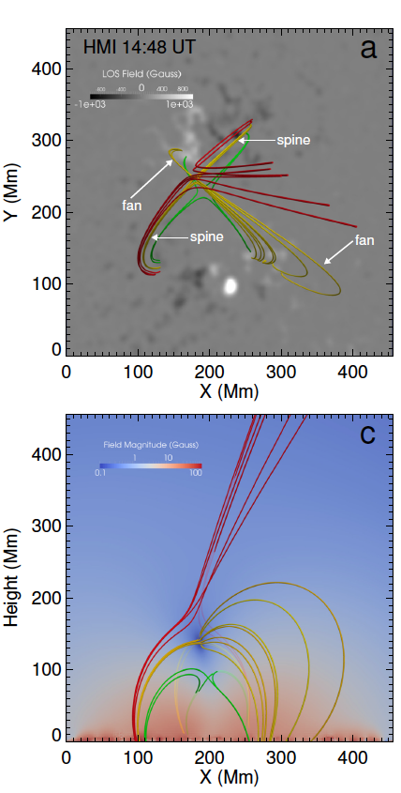
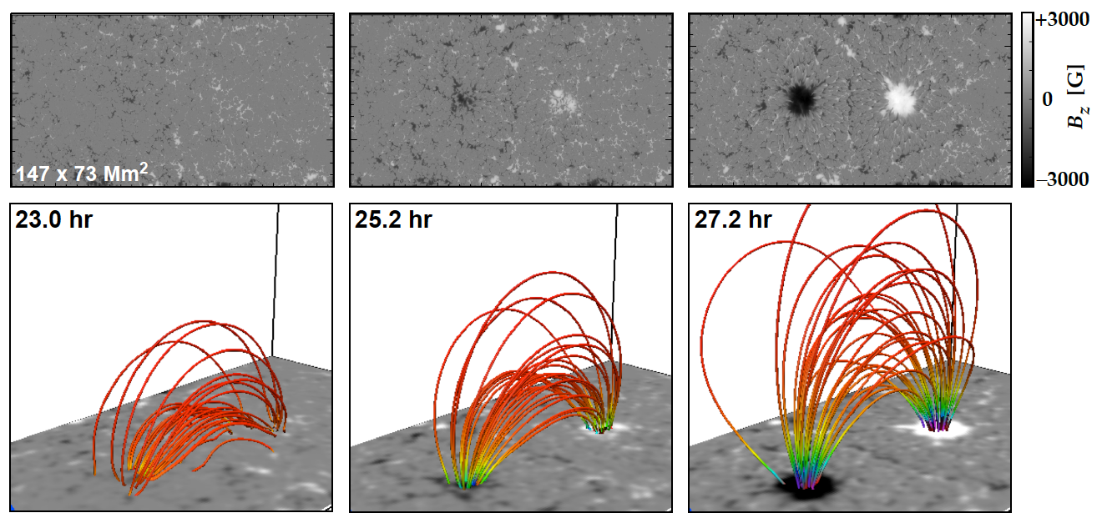
Data driven and NLFFF modeling
Why not just take observed magnetic fields and drive solar atmosphere models?
NLFFF extrapolations - assume equilibrium described by JxB=0, assumes low beta (force-free)
Peter at al. (2015) “Free energy estimates cannot be trusted with NLFFF extrap.s”
Data-driven models - Must include lower atmosphere (cannot drive force-free corona with forced data)
NLFFF extrapolations
Sun et al. (2014)
Leake at al., GMU Seminar, December, 2015

Slide 9
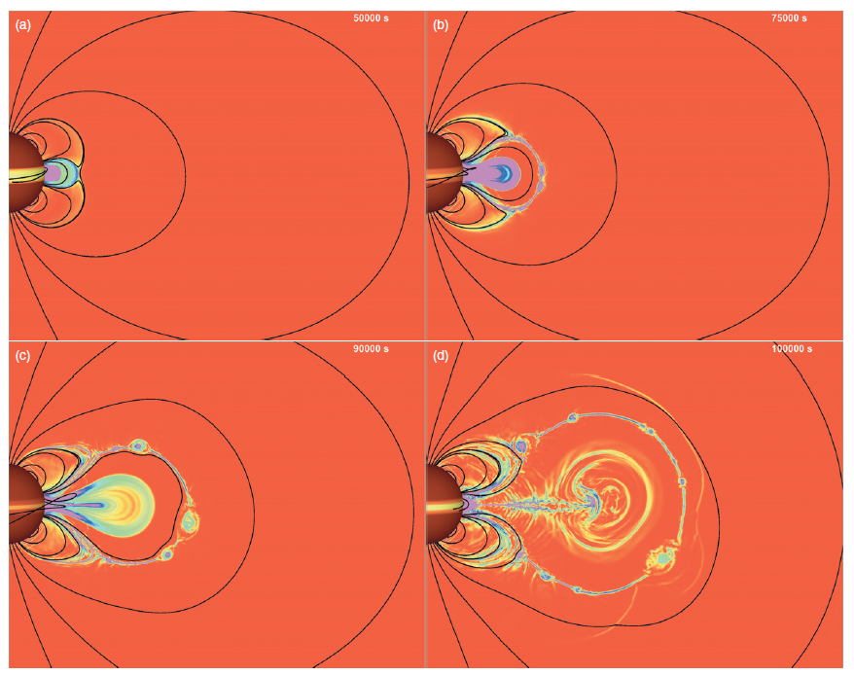
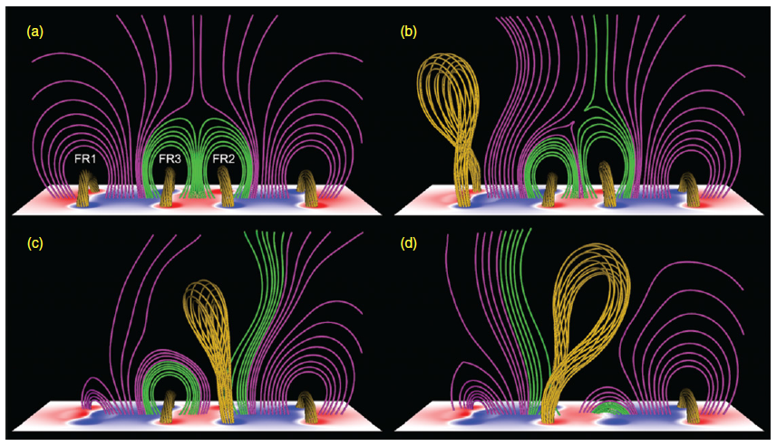
Coronal Modeling
Ignore the emergence process and model corona only
use signatures of emergence such as shearing and flux cancellation to
energize/destabilize coronal structures
Sunspot Rotation/Shearing Motions/Flux Cancellation - that lead to energization
What can we learn from emergence simulations to help with coronal modeling?
Karpen et al., 2012, ApJ
Török et al.
Leake at al., GMU Seminar, December, 2015

Slide 10
Contents
Background
MHD Simulations of Flux Rope Formation and Eruption
Helicity Injection in the Solar Atmosphere
Electrical Current Balance in the Corona
What’s next?
Leake at al., GMU Seminar, December, 2015

Slide 11
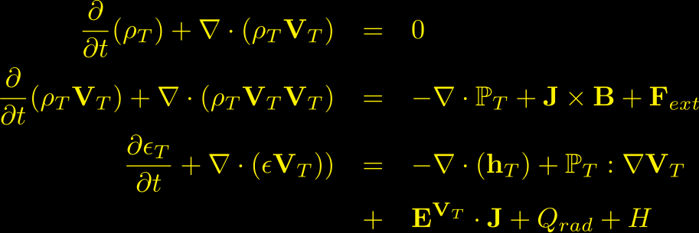
MHD Modeling of the Sun
Box in the Sun: Cartesian Domain representing part of Sun, from upper CZ to lower corona (-20 Mm to ~100 Mm)
Solve equations of visco-resistive MHD
Beta
Corona
Leake at al., GMU Seminar, December, 2015

Slide 12
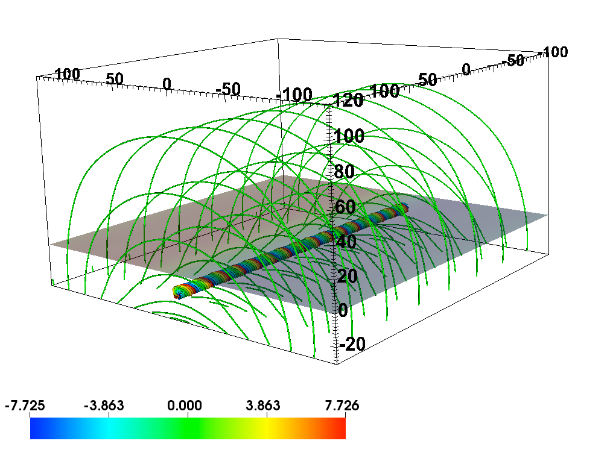
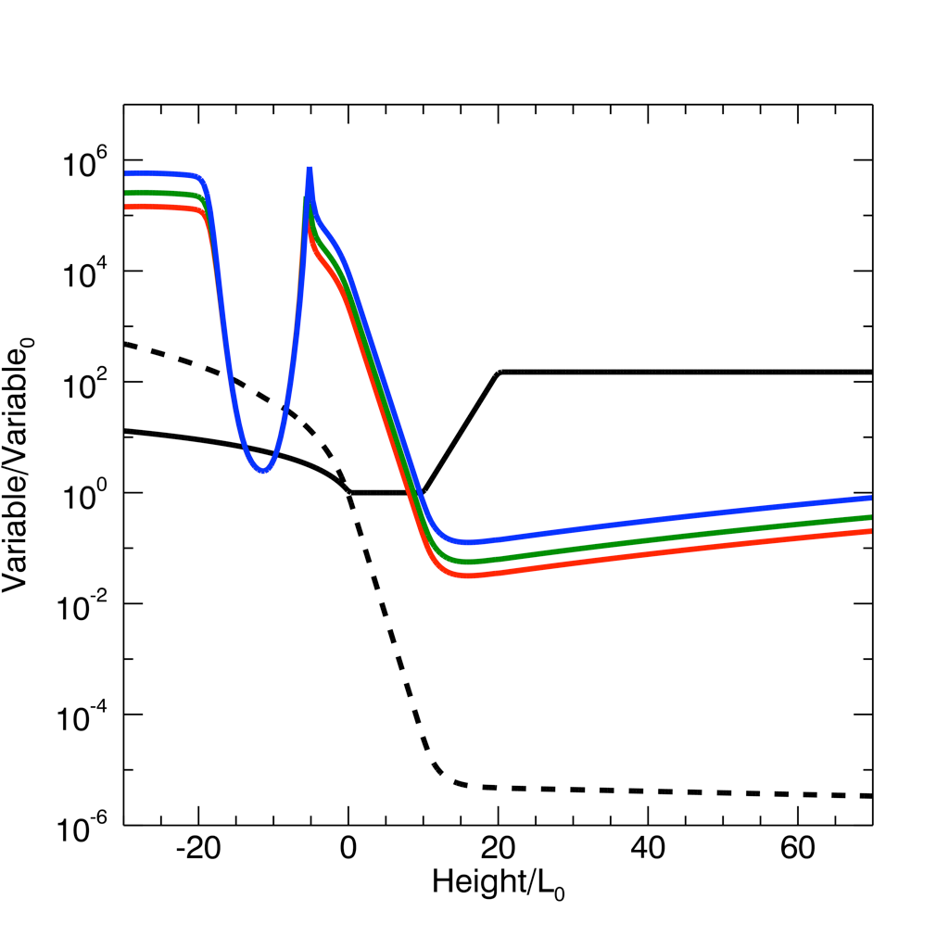
MHD Simulations
Chromosphere
Beta
dipole field
Corona
TR
Temperature
SD MD WD
Leake et al. (2013,2014)
KG buoyant
twisted flux tube
CZ
Bz (G)
Pressure
Surface Bz (G)
Vary dipole strength - Strong (SD) Medium (MD) and Weak (WD)
Vary relative orientation of emerging tube and dipole
Leake at al., GMU Seminar, December, 2015

Slide 13
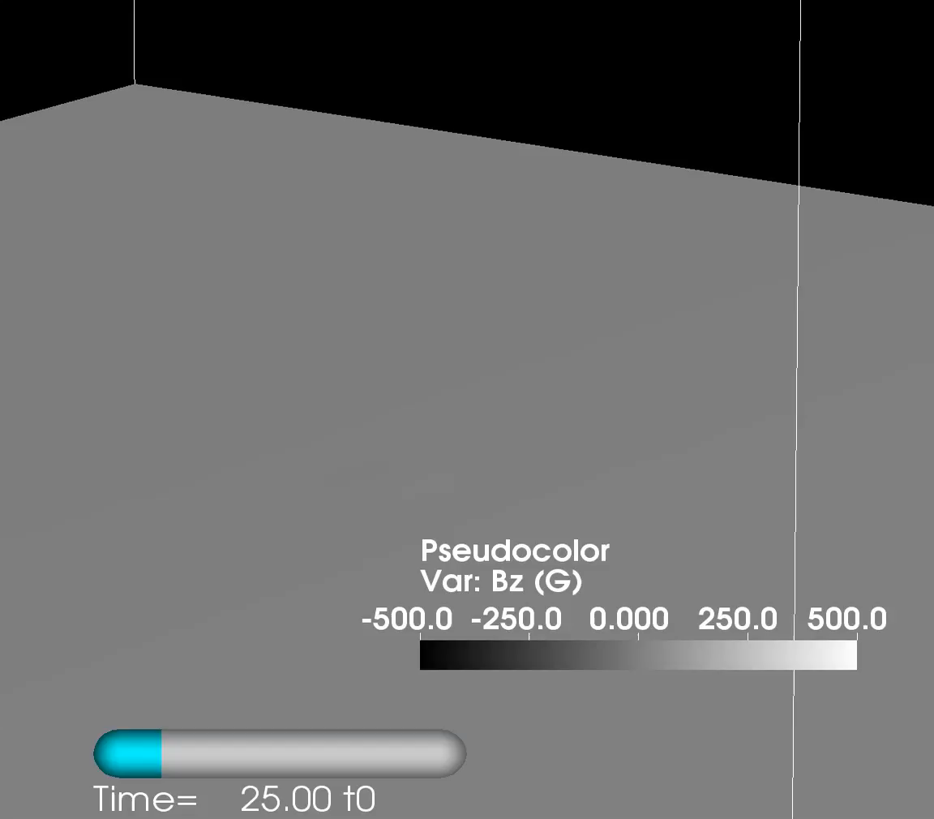
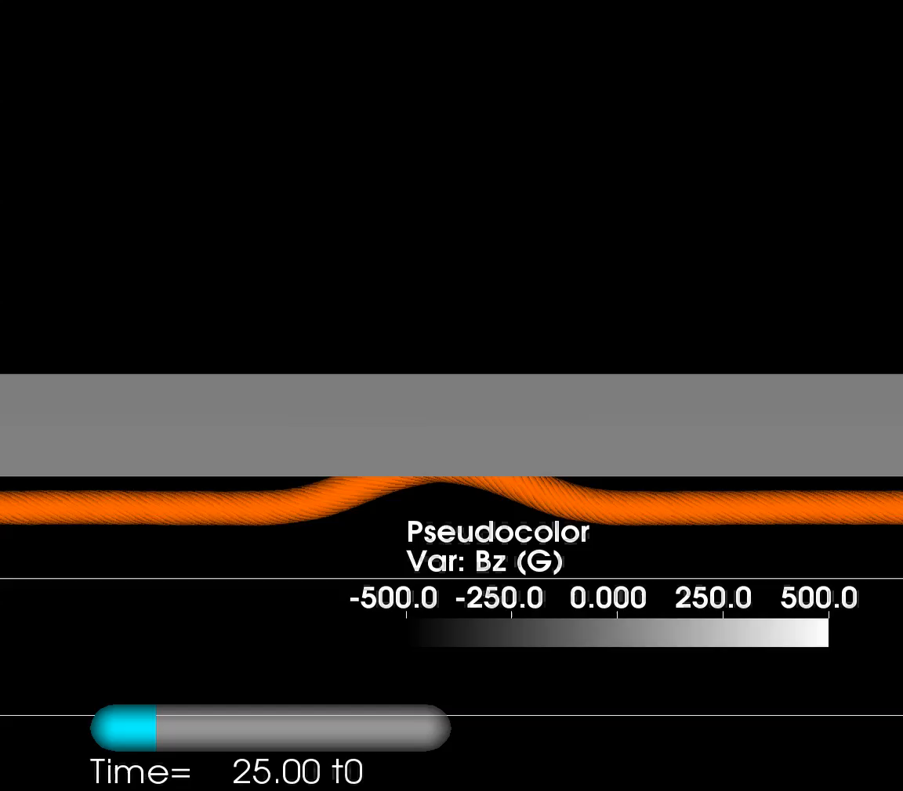
Observed Magnetic Features in SImulations
t<100 t0: emerging flux tube has little interaction with dipole
Partial flux tube emergence accompanied by shearing and rotational motions on surface (Manchester 2004, Fan 2009)
Further emergence (>100 t0) affected by overlying dipole field
Leake at al., GMU Seminar, December, 2015

Slide 14
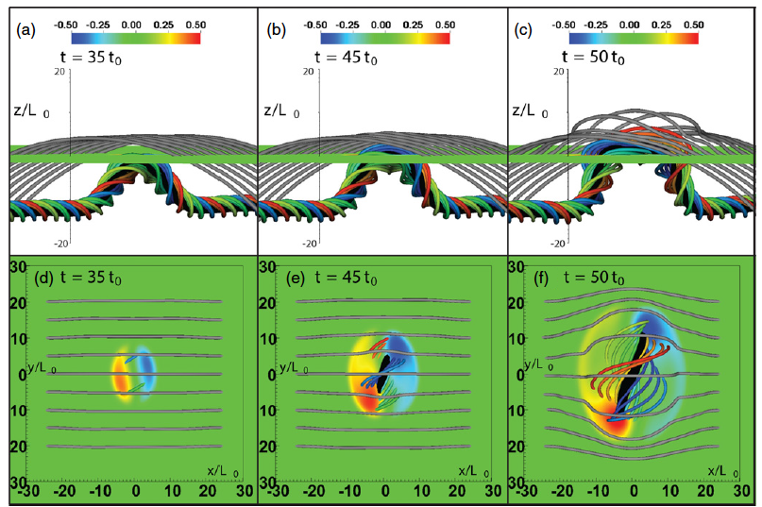
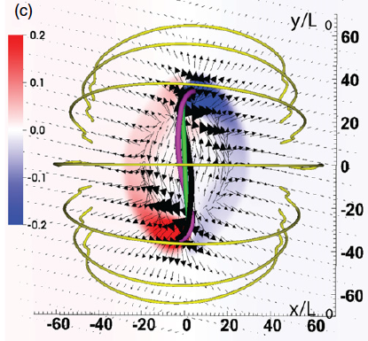
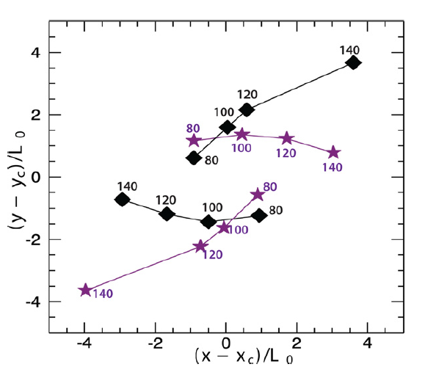
Observed Magnetic Features in SImulations
Shearing caused by emergence of constant twist tube
What is cause of rotational motion?
Leake at al., GMU Seminar, December, 2015

Slide 15
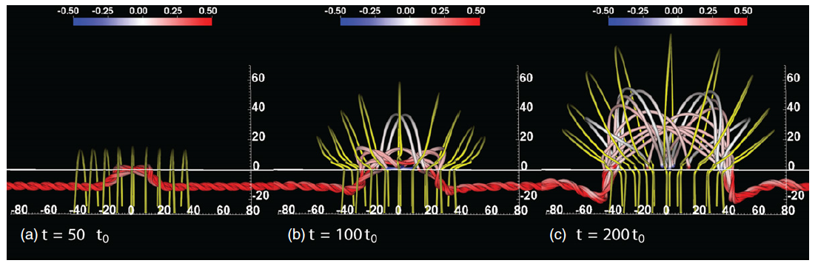
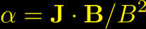
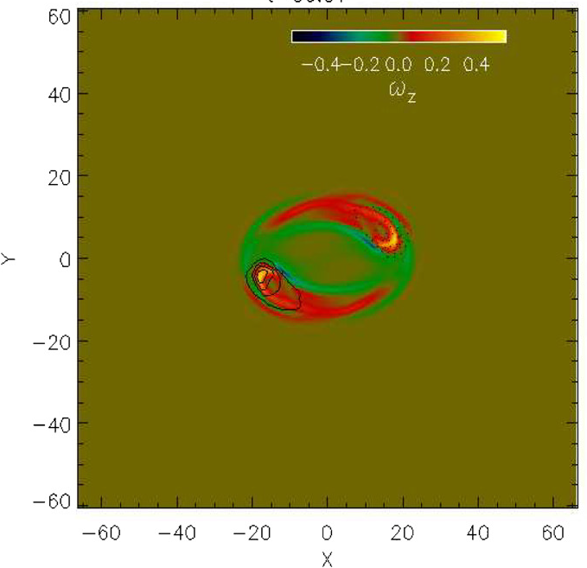
Cause of Rotations?
As concave down part of fieldlines emerge into corona, they lengthen
Twist/length (alpha) decreases in corona?
Creates torque imbalance along fieldlines
Equilibration creates torsional Alfven waves - manifest in rotations at surface
Leake at al., GMU Seminar, December, 2015

Slide 16
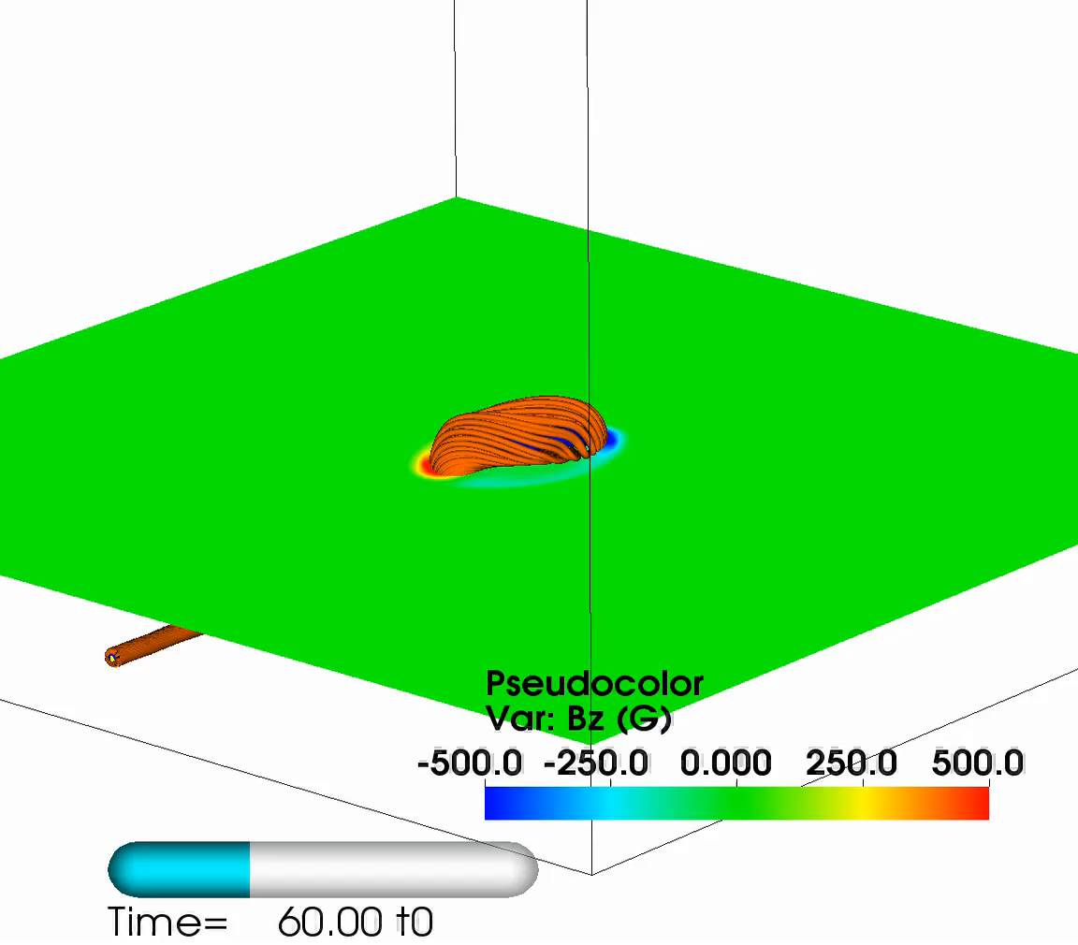
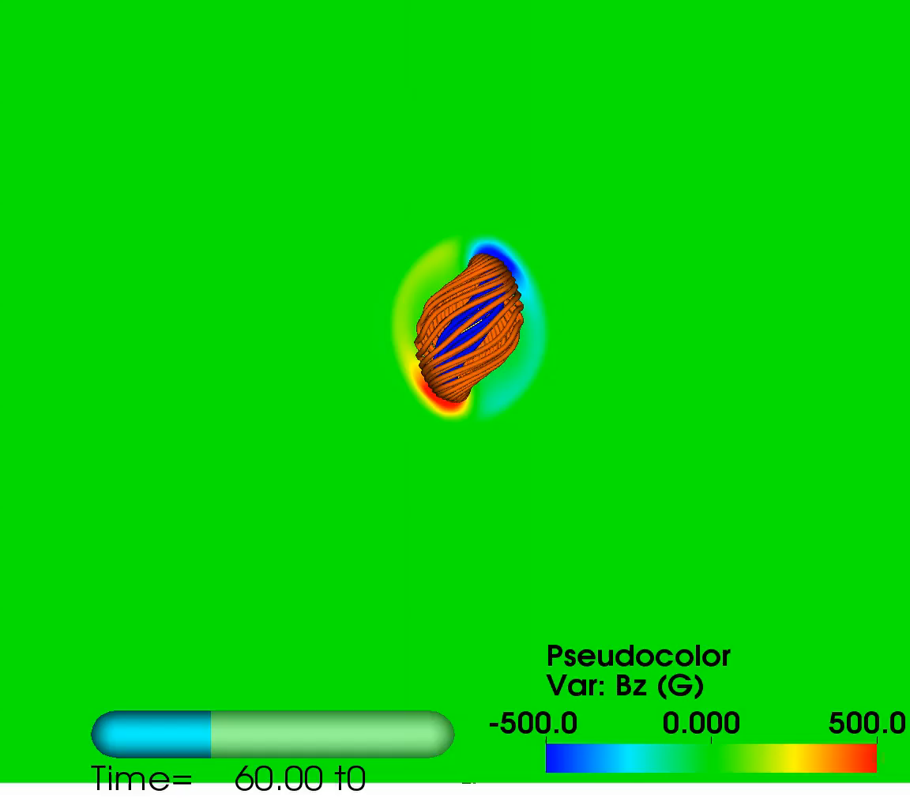
‘Breakout’ Reconnection with Overlying Field
Overlying dipole not shown
Reconnection removes overlying magnetic field and allows central arcade to expand vertically
Quadrupolar structure formed
Leake at al., GMU Seminar, December, 2015

Slide 17
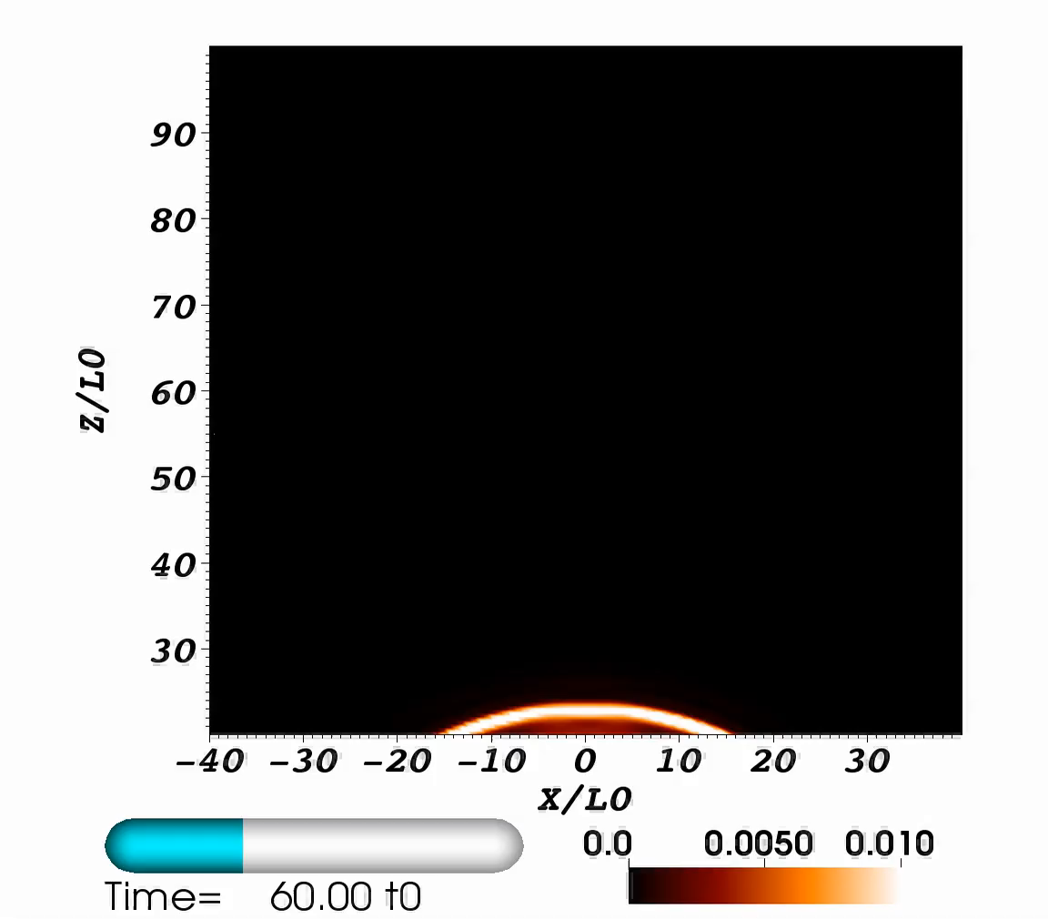
‘Breakout’ Reconnection
Separatrix between emerging field and dipole field
Current sheet, plasmoids - magnetic reconnection
Leake at al., GMU Seminar, December, 2015

Slide 18
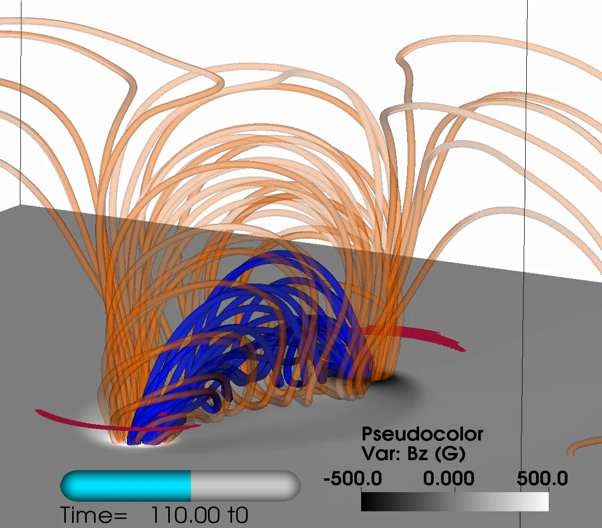
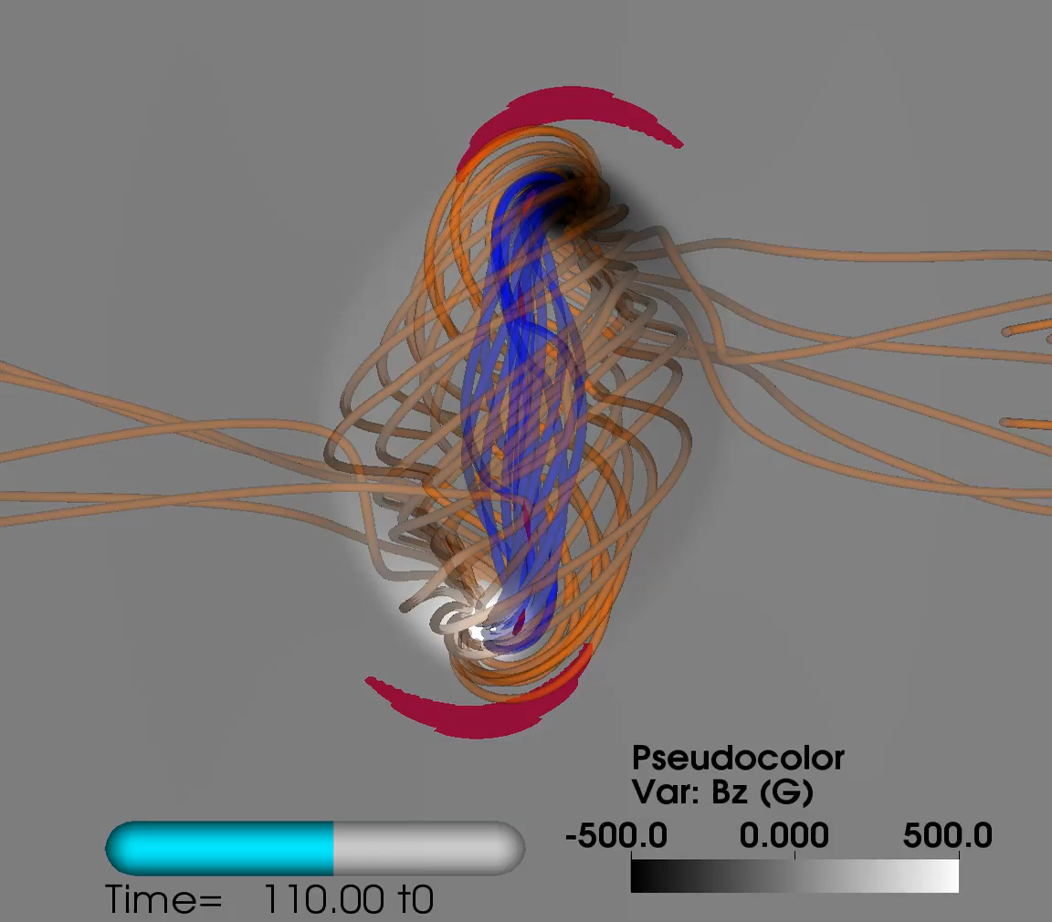
Flux Rope Formation
Vertical expansion of B field creates currents.
Current density ribbons
Two J-shapes become S-shapes - sigmoid
Internal reconnection of emerging arcade creates new flux rope
Leake at al., GMU Seminar, December, 2015

Slide 19
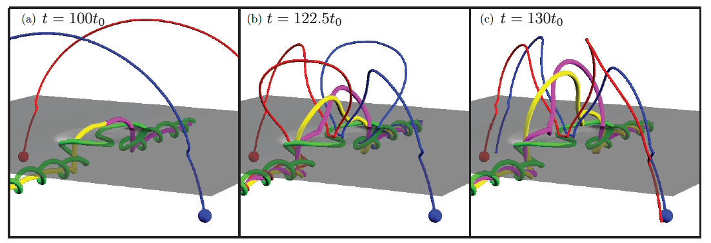
Flux Rope Formation
Look at connectivity of magnetic field during multiple reconnection events
Leake at al., GMU Seminar, December, 2015

Slide 20
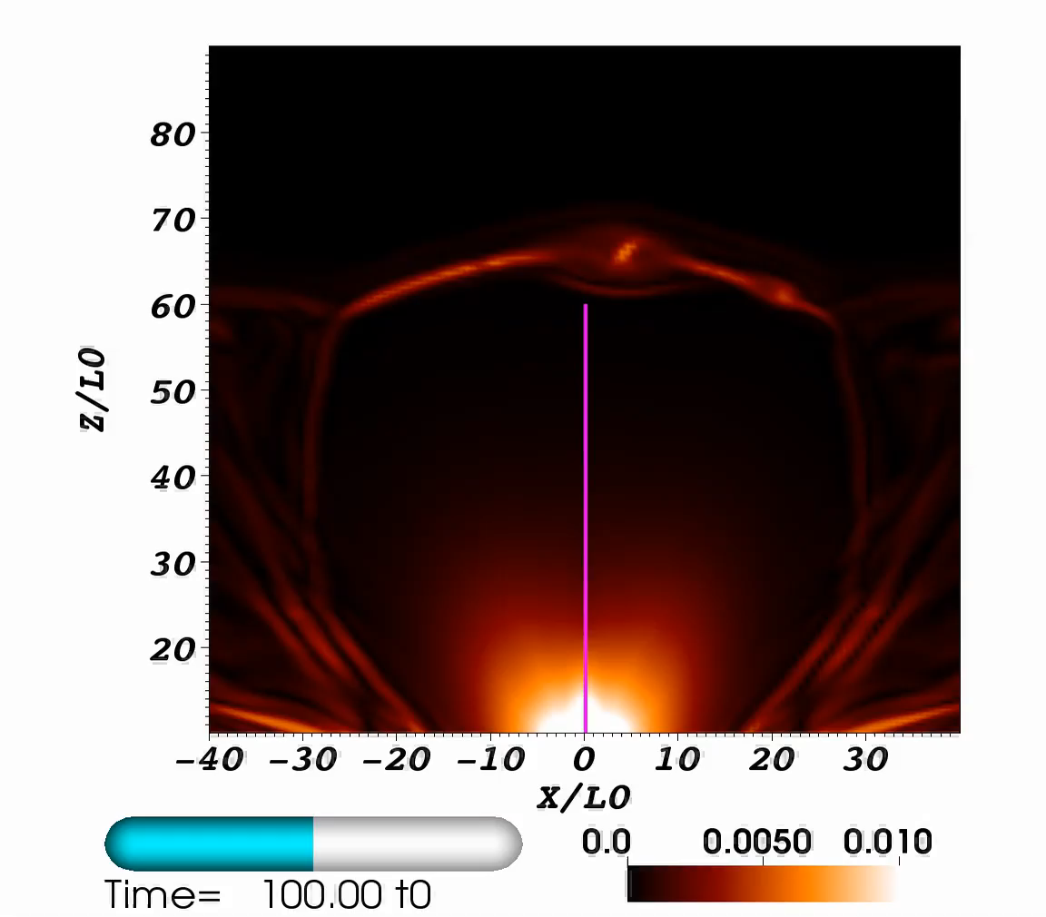
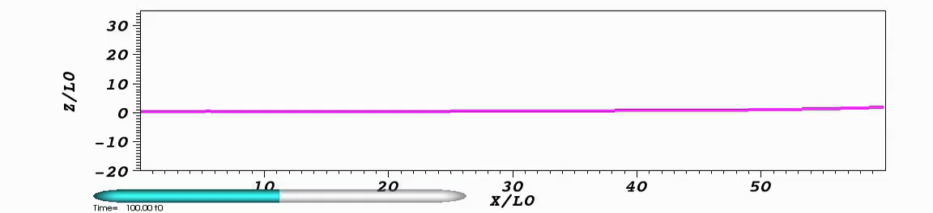
‘Flare’ Reconnection
- Slow rise of flux rope
- ‘Horns’ beneath flux rope
- Current sheet beneath
- Fast rise of flux rope
- Reconnection
- Bi-directional flows
- Short post-flare loops
Vertical velocity
Leake at al., GMU Seminar, December, 2015

Slide 21
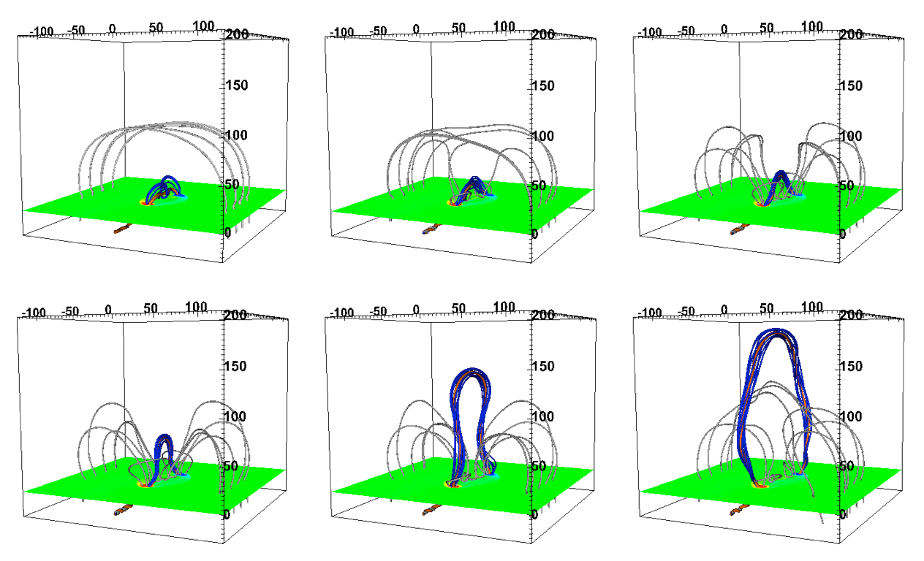
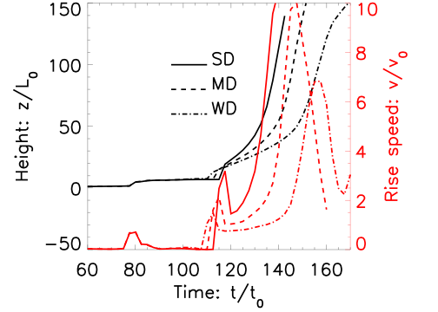
Flux Rope Eruption
Eruption followed until rope hits top of simulation domain
Eruption ~ 100 km/s (slow)
These ARs have 10^19 Mx flux
Does eruption speed scale with size of AR?
Leake at al., GMU Seminar, December, 2015

Slide 22
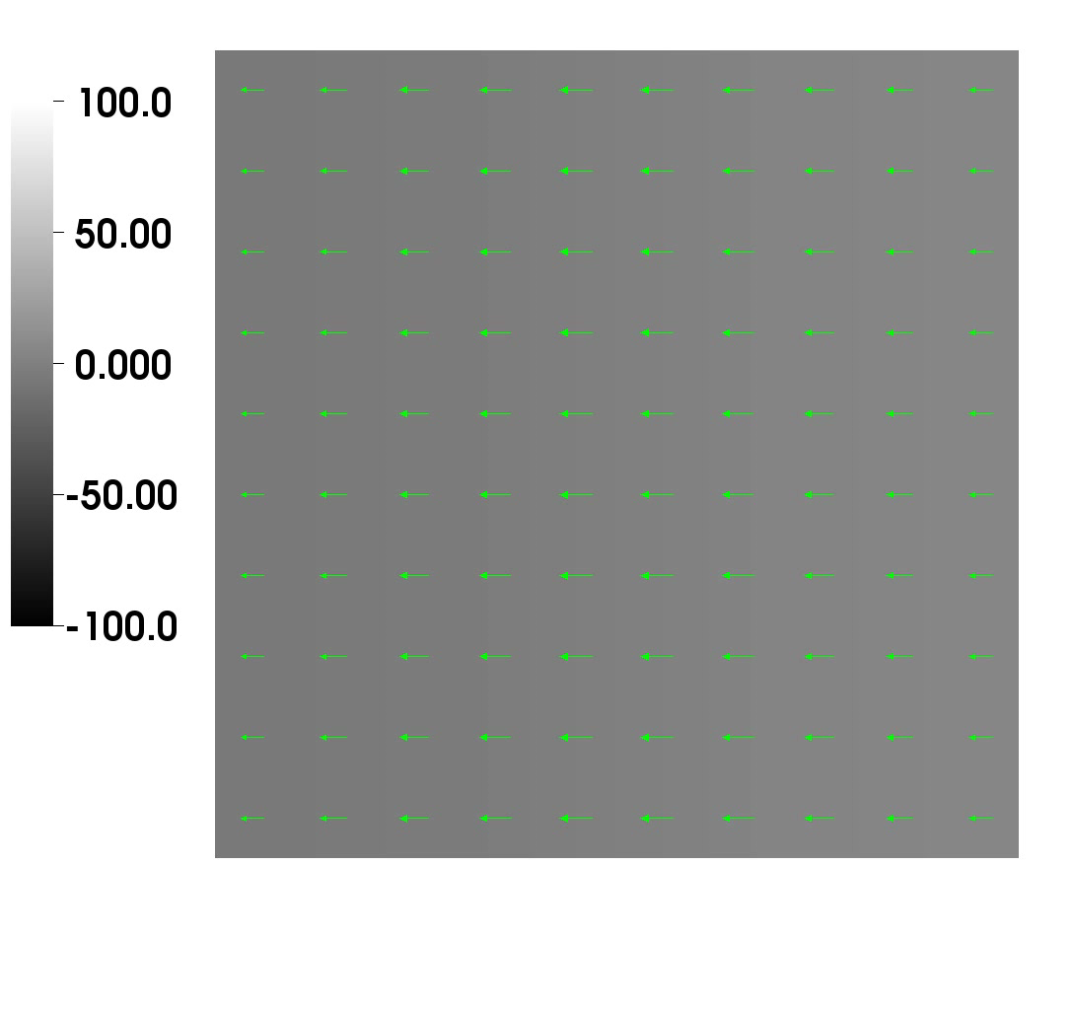
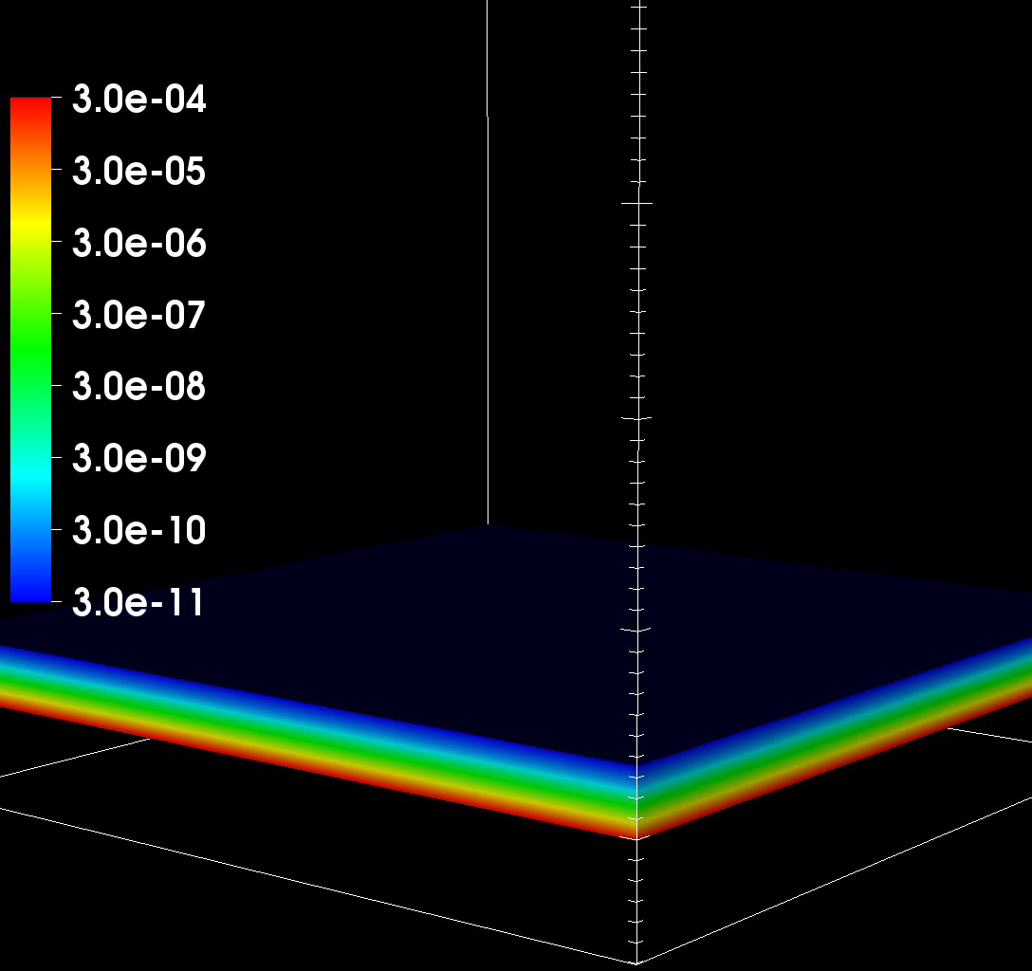
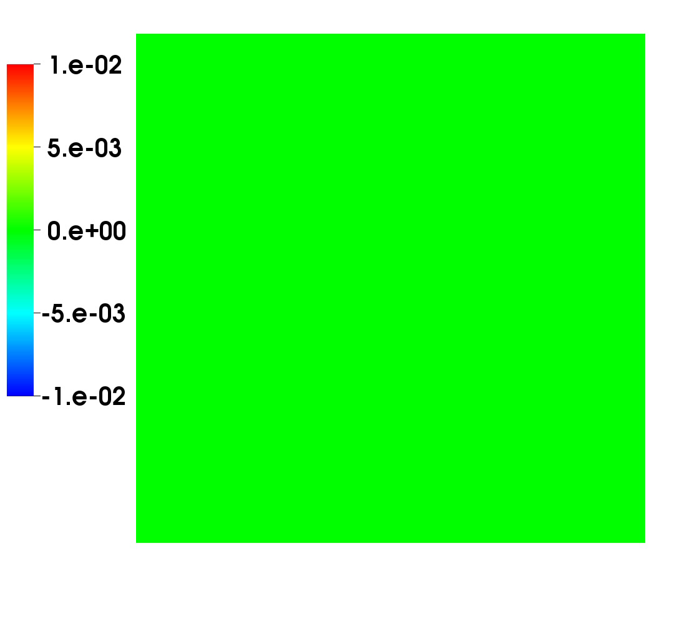
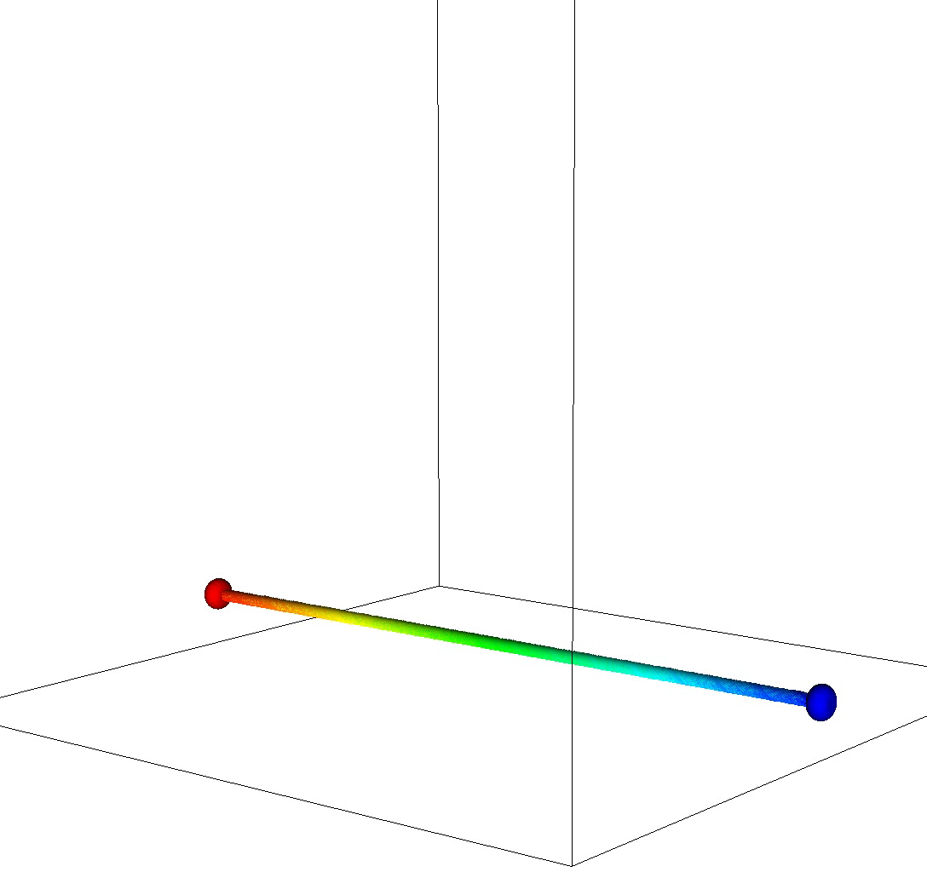
Flux Rope Eruption
Bz
Density
Jz

Slide 23
Contents
Background
MHD Simulations of Flux Rope Formation and Eruption
Helicity Injection in the Solar Atmosphere
Electrical Current Balance in the Corona
What’s next?
Leake at al., GMU Seminar, December, 2015

Slide 24
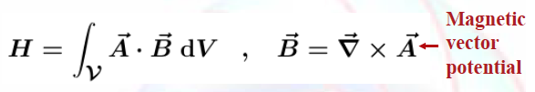
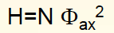
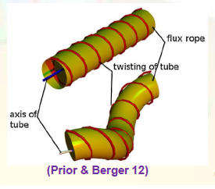
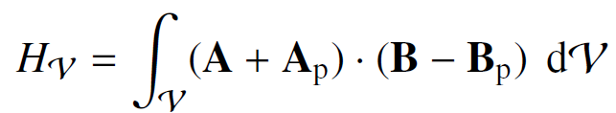
Helicity and Space Weather
Helicity
Important quantity in terms of solar activity/CMEs
Conserved in ideal MHD, in our sims ~3% loss
For uniformly twisted tube
Relative helicity may be important quantity for studying productivity of an AR
Leake at al., GMU Seminar, December, 2015

Slide 25

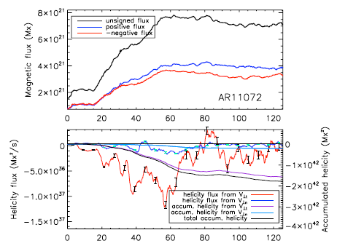
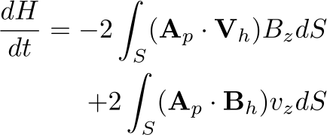
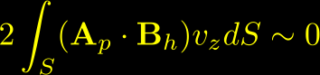

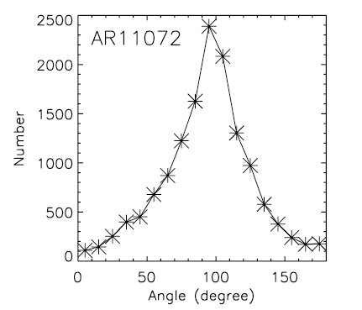
Helicity Observations
Relative magnetic helicity: Measure of complexity of field (twist, writhe)
Liu and Schuck 2012, AR11072
horiz. flows
vert. flows
Pariat et al. 2005, Demoulin and Berger, 2003.
Liu and Schuck 2012
Potential field
time (hours)
horizontal flow contribution dominates
Helicity flux at surface dominated by horizontal flows mixing potential field?
Use sims. to help understand helicity injection
Leake at al., GMU Seminar, December, 2015

Slide 26
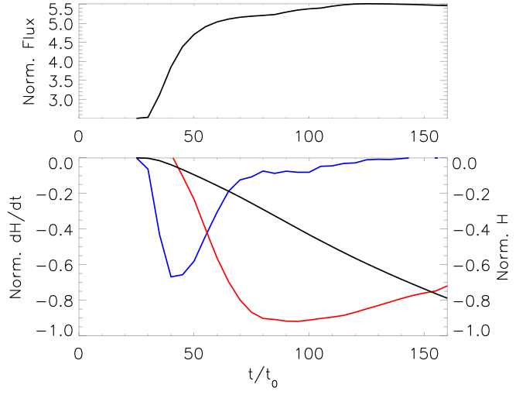
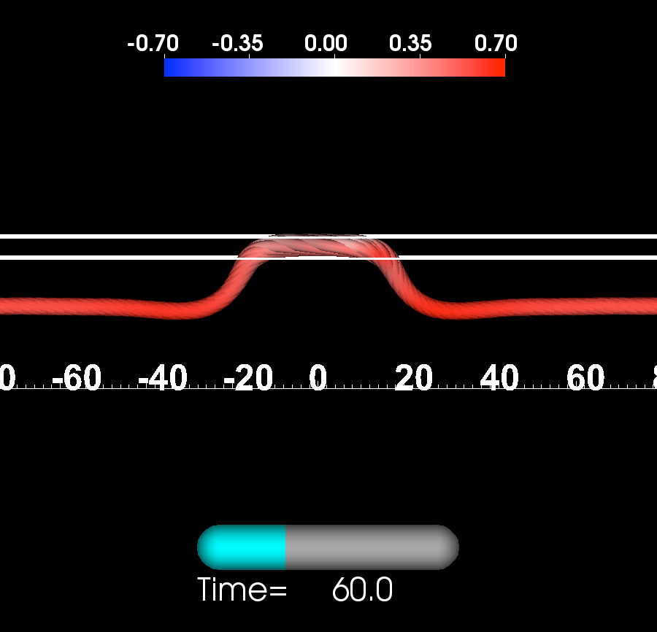
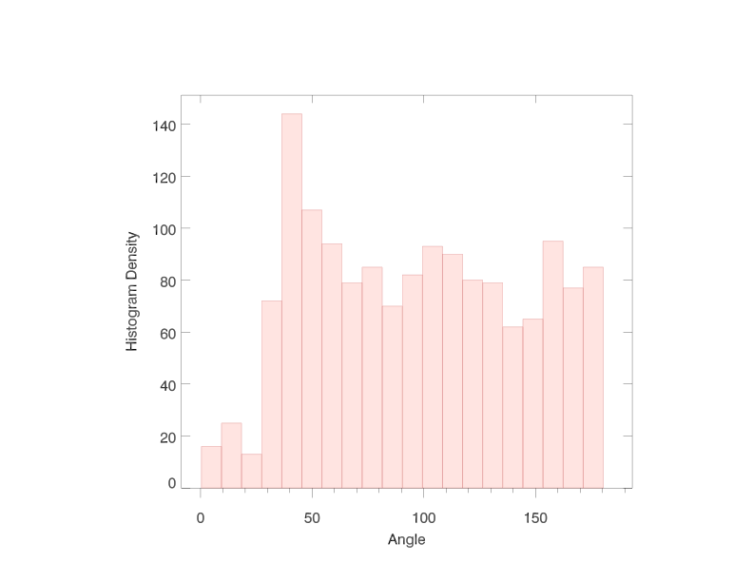
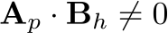
Helicity Injection in Simulations
Total Unsigned Flux
z=0
j.B/B²
z=0
z=0
dH/dt
Vert.
flows
Total
Helicity
dH/dt
Horiz. flows
Twisted tube bodily emerges above z=0
Vertical flows initially dominate dH/dt
Horizontal flows dominate later
Leake at al., GMU Seminar, December, 2015

Slide 27
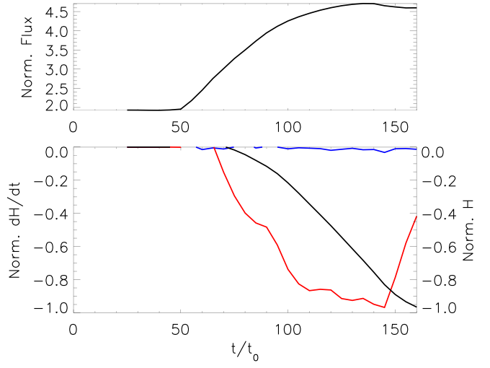
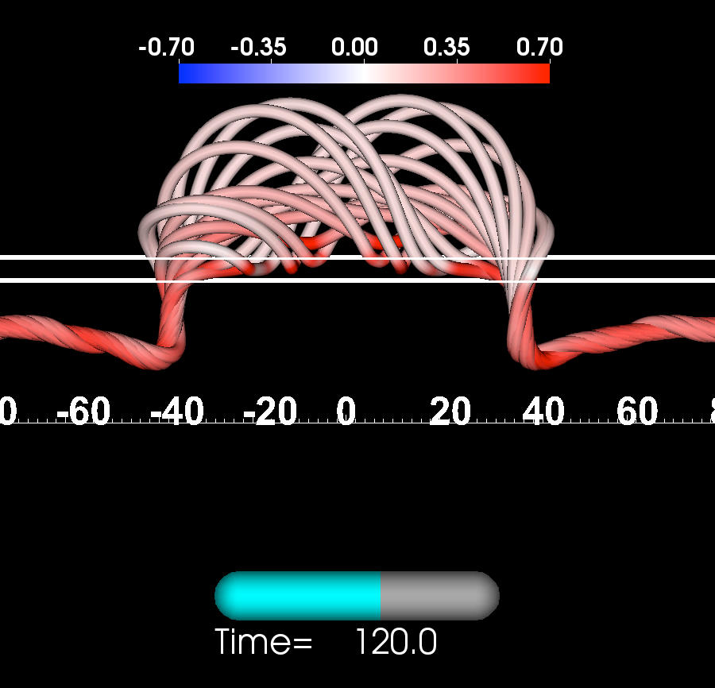
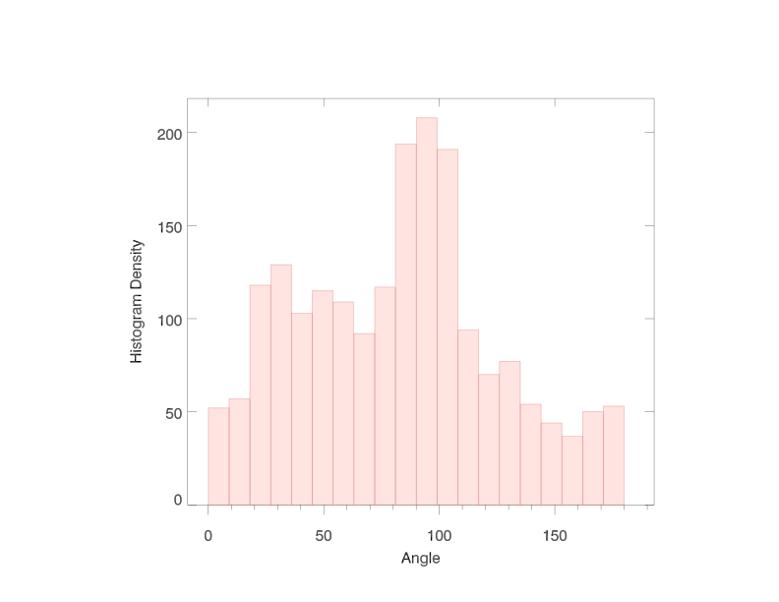

Helicity Injection in Simulations
z=2.5
z=2.5
z=5
dH/dt
Vert.
flows
Total
Helicity
j.B/B²
dH/dt
Horiz. flows
No bodily emergence above z=2.5
Horizontal flows dominate (only potential field emerges?)
Need better decomposition of dH/dt
Leake at al., GMU Seminar, December, 2015

Slide 28
Contents
Background
MHD Simulations of Flux Rope Formation and Eruption
Helicity Injection in the Solar Atmosphere
Electrical Current Balance in the Corona (if time)
What’s next?
Leake at al., GMU Seminar, December, 2015

Slide 29


Motivation and Theoretical Considerations
AR currents (J=curl(B)), the source of CME/flare energy, are believed to be created by
stressing of coronal magnetic field and/or emergence of current carrying flux from interior
Melrose argued that currents in corona cannot be generated by shearing motions, but must close in the interior
Faraday’s law requires that isolated flux tubes carry no net current
If isolated, current neutralized, magn. flux tubes link into the corona, then would expect to observe balance ‘direct’ and ‘return’ current at footpoints
Why should we care whether coronal currents are neutralized or not?
Do we see these return currents in photospheric observations? Very little analysis so far.
Melrose (1995)
FIX
+
-
+
-
+
-

Slide 30

Motivation and Theoretical Considerations
Why should we care ?
The subject of electric current neutralization has lead to lively debate (not now) about:
the nature of coronal flare energy storage and energization
how to describe time-dependent coronal system (V,B vs E,J) - Leake et al. SSRv (2014)
Successful theoretical/numerical CME models use initial conditions based on non-neutralized current-carrying coronal flux ropes
Török and Kliem (2005), WIlliams et al. (2005), Schrijver et al. (2008), Kliem et al. (2010,2012,2013)

Slide 31



Observations: Flare region
Ravindra et al. (2011), Georgoulis et al. (2012)
Flare-producing AR 10930
Find a net current in each polarity
Onset of flares seems to depend on decrease in this net current
Concluded that shear at PIL is important for net current

Slide 32



Observations: AR 11072 and 11158
Courtesy Yang Liu
AR 11072/11158
11158 highly sheared PIL and non-neutralized
Is shear at PIL necessary for non-neutralization?
Bommier et al.
Themis

Slide 33

Early Model for flux tube emergence
How can we get non-neutralized atmospheric currents from neutralized interior flux structures?
Longcope and Welsch (2000)
Twisted flux tubes emerges into field-free corona
Initially, no twist emerges
Launches Torsional Alfven wave which twists up the coronal field
Return currents of the subsurface field are confined to the surface (why?)
Let’s look at a dynamic simulation of flux emergence

Slide 34


Simulations of flux tube emergence
Key feature is flux pile up near surface before emergence
Top of tube emerges first, later emergence builds up current in corona
Where does the return current go?
Is there a net current in the atmosphere?

Slide 35


Initial results (Török et al. 2014)
Perform at two times, before and after significant shearing
Analyze direct and return currents in the atmosphere
Do same surface integral as obs papers
+ve polarity and +ve region

Slide 36

Initial results (Török et al. 2014)
+ve region
+ve sunspot
Current analysis
Direct: Jz*Bz>0, Return: Jz*Bz<0
Significant net current in these simulations
Strong shear at PIL

Slide 37

Comparison with center of AR11158
Significant net current in these simulations
What is the role of magnetic shear?
Where do the return currents go?

Slide 38





Insights from coronal modeling
Dalmasse et al. (2015)
Apply various surface motions to generate current in a dipole field
More the PIL is sheared, the more non-neutralized the currents
PIL

Slide 39

Current paths
Look at connectivity of current fieldlines
Selected fieldlines originating in regions of direct and return current in CZ
See ‘short-circuit’ of fieldlines
Direct current mainly follows simple path in and out of corona - thus contributing to direct current Jz calculation
Return current forms complicated paths at edge of emerging region
can enter and leave corona in same polarity - does not add to return current jz calculation

Slide 40
Contents
Background
MHD Simulations of Flux Rope Formation and Eruption
Helicity Injection in the Solar Atmosphere
Electrical Current Balance in the Corona (if time)
What’s next?
Leake at al., GMU Seminar, December, 2015

Slide 41

New Studies in Progress
Do the flux rope formation and eruption mechanisms seen in small scale simulations occur on AR scales?
Sims shown today
Vary free parameters in model to better match emergence rates, AR fluxes, AR twist
Leake at al., GMU Seminar, December, 2015

Slide 42




New Studies in Progress
Chromospheric physics beyond a simple transition from CZ to corona
Dissipates cross-field currents
Twisted flux tube
Leake at al. (2006, 2013)
Initial
Later
Partial Ionization model needs better treatment of thermodynamics
Leake at al., GMU Seminar, December, 2015

Slide 43



New Studies in Progress
Currently have vector magnetic field data at surface from SDO/HMI on 12 min cadence - is it enough?
Use emergence simulation as ground truth and drive atmosphere only model with surface data at varying cadence
Use volume integrated errors from Shrijver paper comparing NLFFF extraps
Errors using HMI cadence can be ~10%
Where are the errors - in free energy?
HMI cad.
Leake at al., GMU Seminar, December, 2015

Slide 44


New Studies in Progress
Driving coronal models with data from our flux emergence simulations
jets
Török et al. in prep
CMEs
Leake at al., GMU Seminar, December, 2015

Slide 45
Summary
Though idealized, flux emergence simulations can help us learn a lot about the energization of the corona
and how eruptions occur
Improving the realism (scales, chromospheric physics, thermodynamics) is necessary to fully utilize them to understand observations
Leake at al., GMU Seminar, December, 2015

